Slide 1
ProDx Q3 2025 The Triangle
August 27th, 2025
Product and Development Team

Slide 2


Triangle
Yes — structurally, the triangle is often considered the strongest geometric shape for distributing force.
Rigid structure: If you push on a square or rectangle, it can deform into a parallelogram without changing side lengths.
Force distribution: That’s why trusses, bridges, and roof supports often use triangular frameworks.
Stability: A triangle’s rigidity makes it excellent for load-bearing.

Slide 3
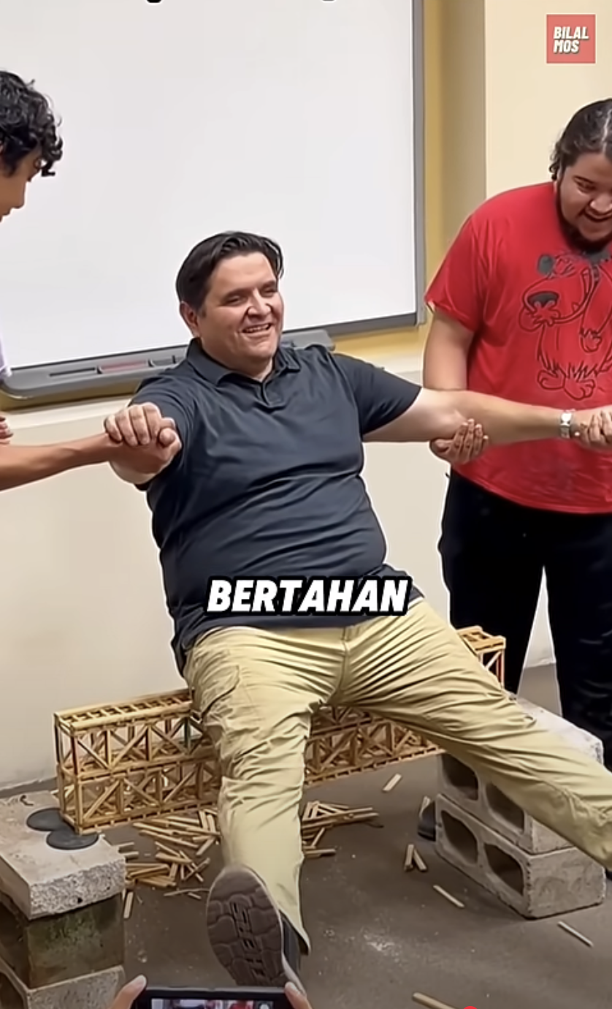

Slide 4
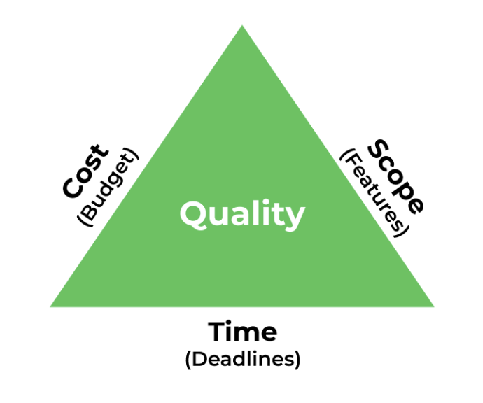
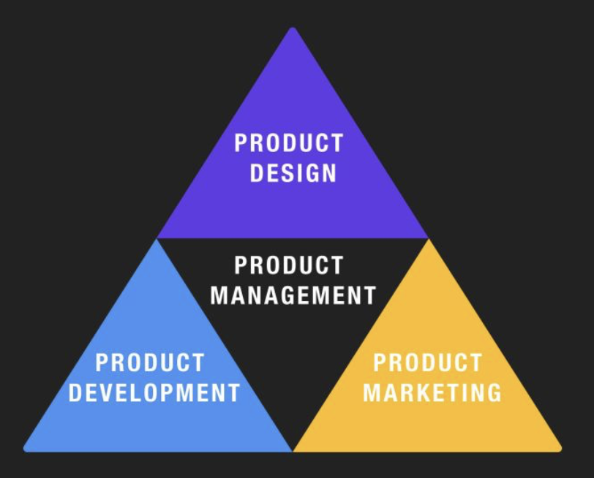
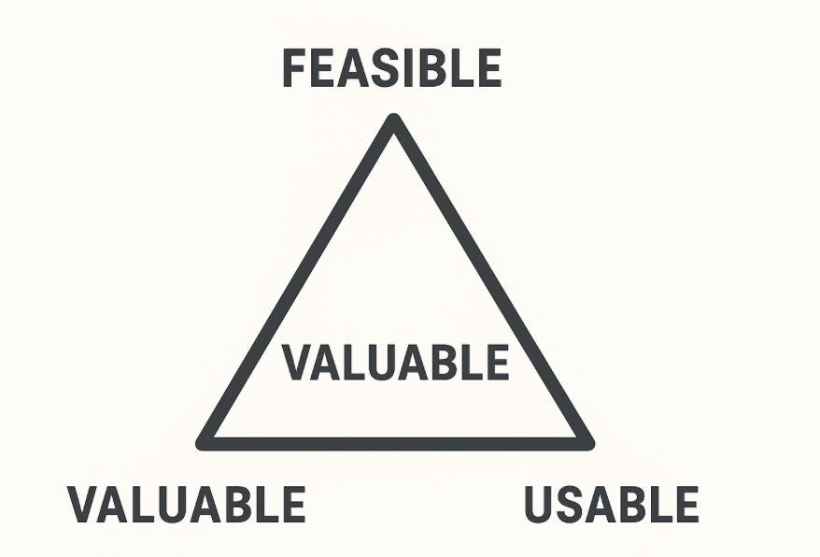


Triangles
VIABLE

Slide 5
Triangles
VIABLE
PROJECT
PRODUCT MANAGEMENT
PRODUCT

Slide 6
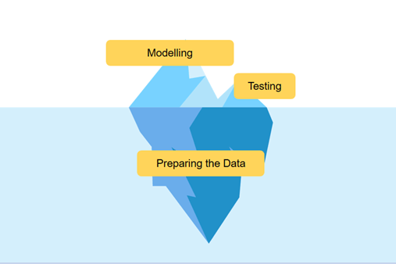

Slide 7
Vision, Team, and Products

Slide 8
Vision If you do not know where you are going, every road will get you nowhere.
When you have vision,
you can walk even with closed eyes.

Slide 9
Vision
CUSTOMER/BUSINESS
“
UPDATED TECH
Building a great product and team
that enhances customer experience
also drives business value.
FUNDAMENTALS
BUSINESS DOMAIN

Slide 10
Vision
CUSTOMER/BUSINESS
“
CSAT-NPS
ACTIVITY
UPDATED TECH
Building a great product and team
that enhances customer experience
also drives business value.
COST EFFICIENCY
INCREASING REVENUE
FUNDAMENTALS
BUSINESS DOMAIN

Slide 11
Team We need teams of missionaries, not teams of mercenaries

Slide 12
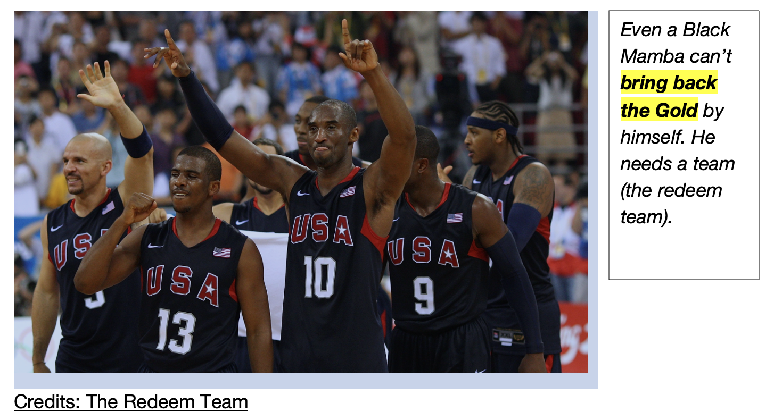
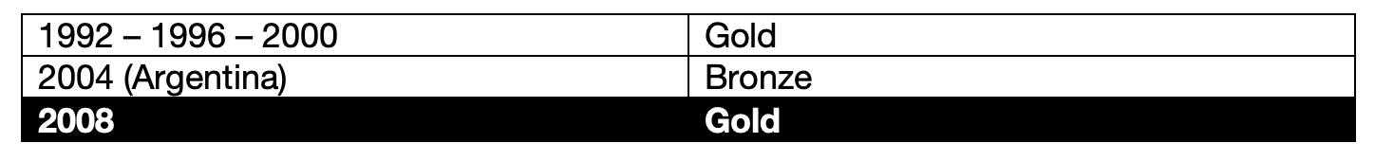

Slide 13
Dwight Howard
Carmelo Anthony
Jason Kidd
Dwayne Wade
Black Mamba
Chris Paul

Slide 14

What’s Team

Slide 15

What’s Team

Slide 16
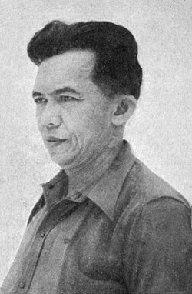
What’s Team
ROBUST
“
TERBENTUR, TERBENTUR, TERBENTUK!

Slide 17
What’s Team
ETHICAL
?
"Give me 10 competent officers and bad laws
rather than good laws and 10 bad officers"

Slide 18
What’s Team
?
Individuals and interactions over processes and tools
Working software over comprehensive documentation
Customer collaboration over contract negotiation
Responding to change over following a plan

Slide 19
Products

Slide 20
Our Products?

Slide 21
Our Products!
CLIENT FACING
CORE SERVICES
INTERNAL TOOLS
BCP
OZON
ADP
ADINUSA PRO TRAINING
ERP
ADINUSA COMMUNITY
BDP
BTECH.ID
B-TEST?
B-LINK?

Slide 22
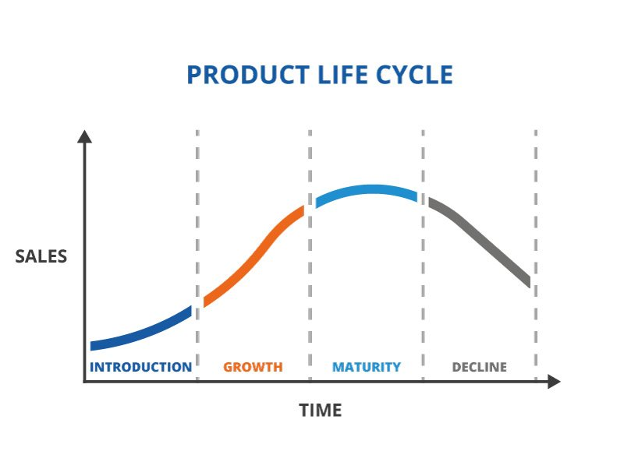

Slide 23
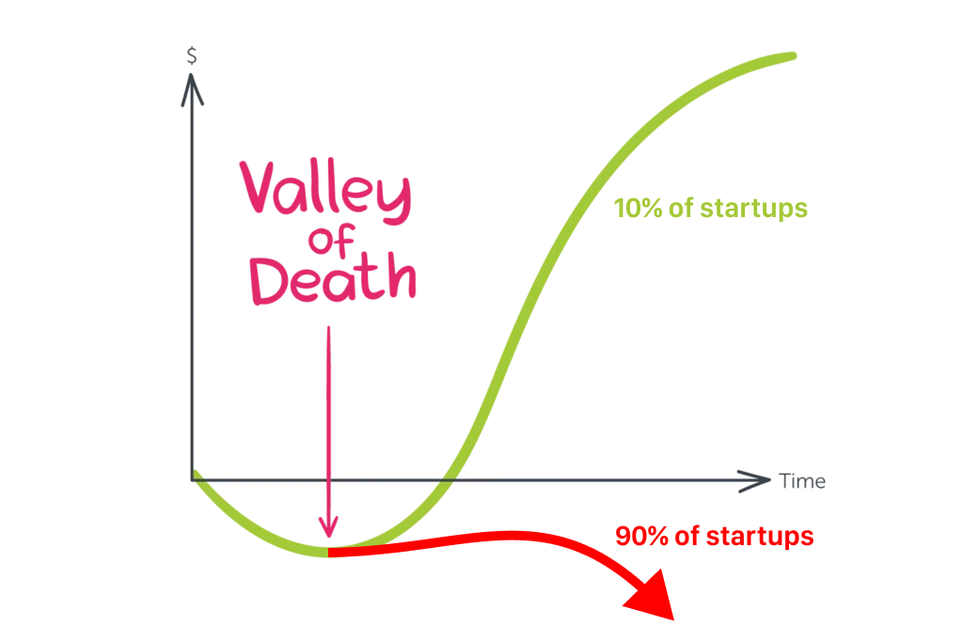
Product Market Fit

Slide 24
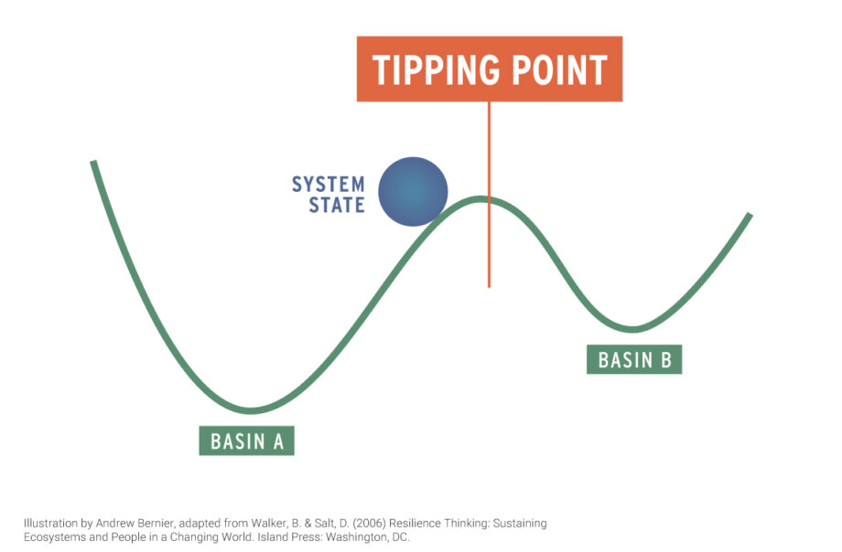

Slide 25
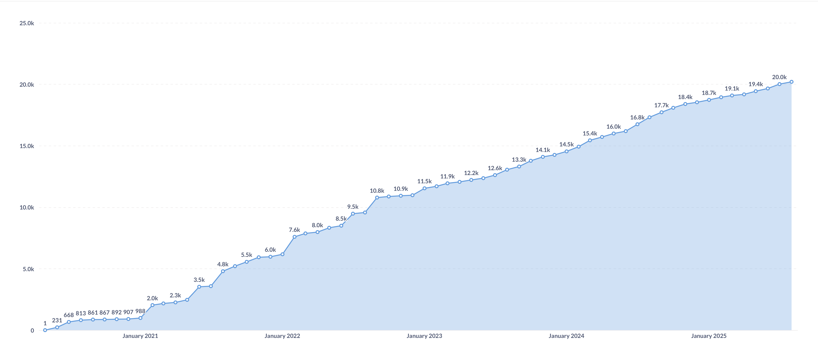

Slide 26
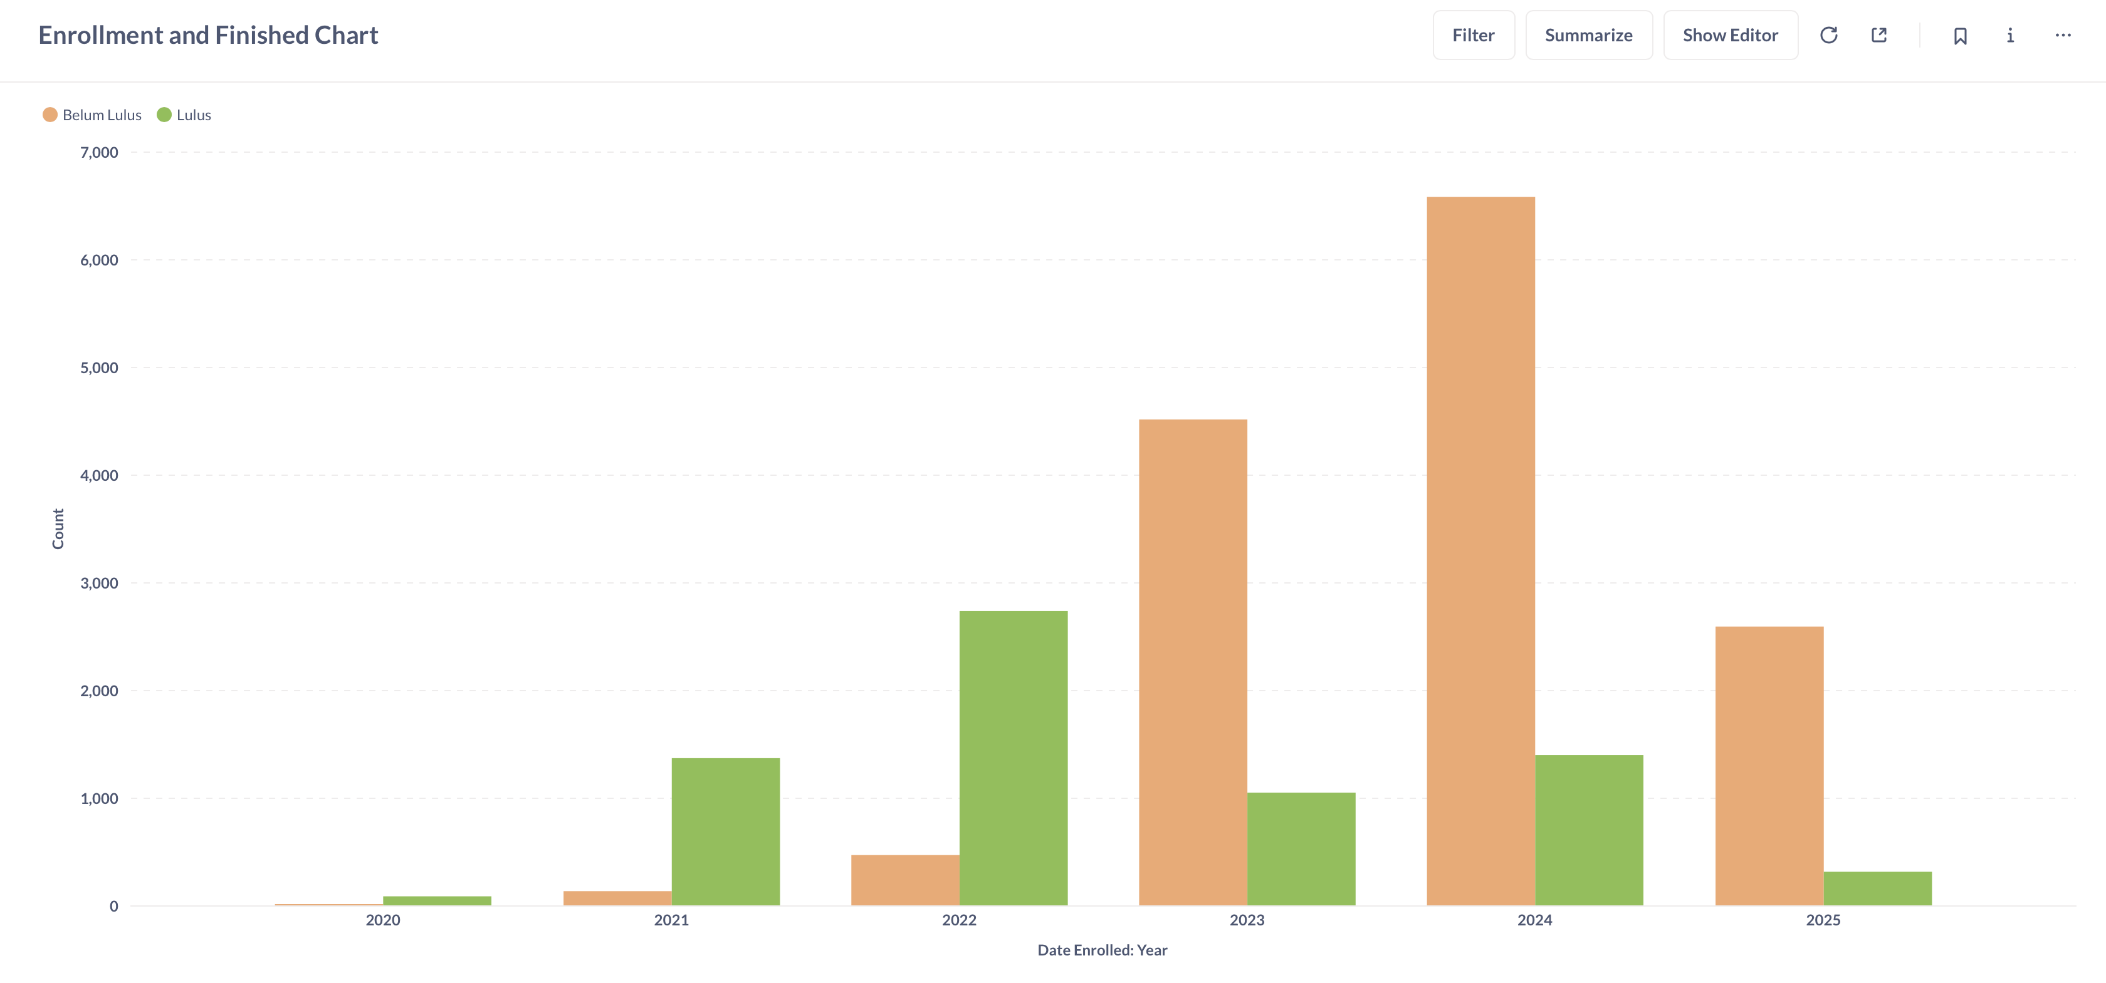

Slide 27

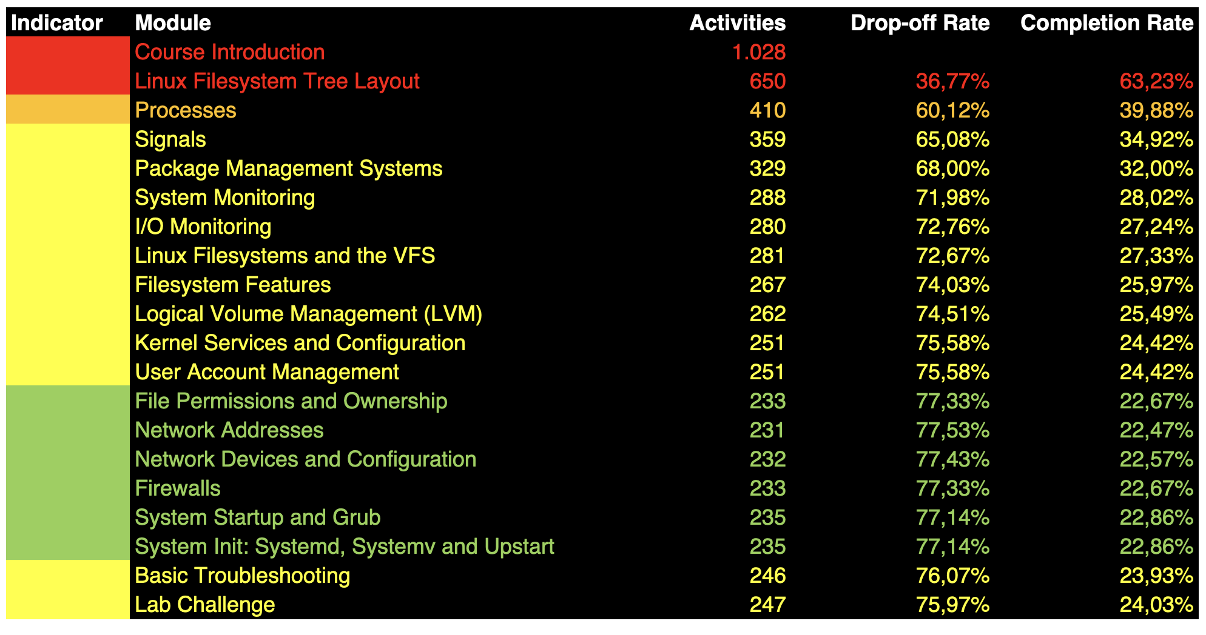
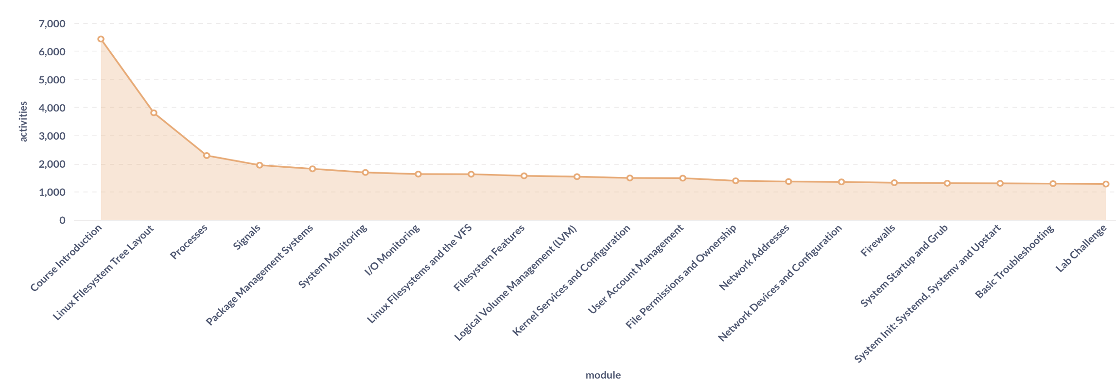

Slide 28
Discovery Started
Development Prepared
New Cover Requested
June
July
August
W1
W2
W3
W4
W1
W2
W3
W4
W1
W2
W3
W4
Initiative Requested
Backlog Refined
Development Started
Released
Handbook and Lab File Download

Slide 29


Slide 30
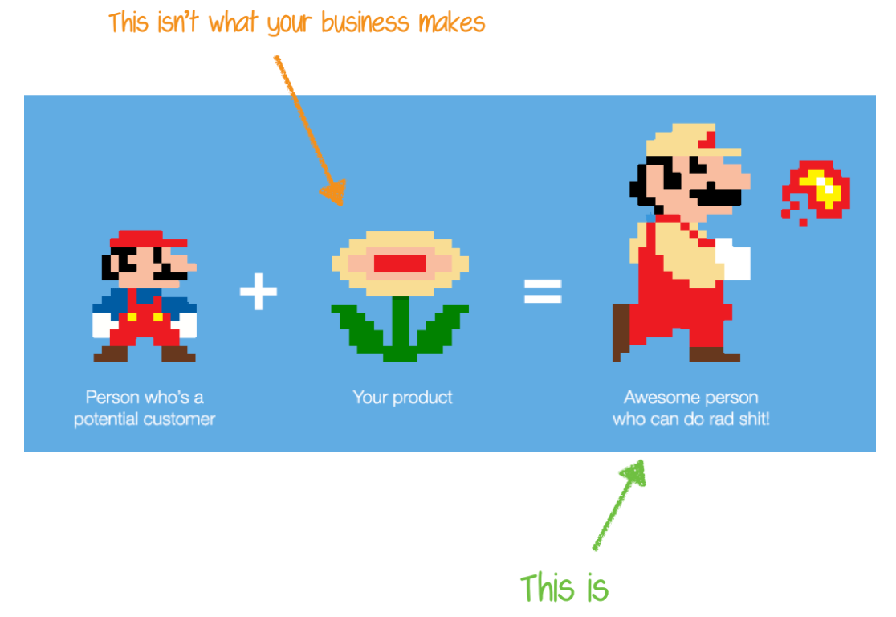
PRODUCTS
VISION
TEAM

Slide 31
Next Episode… _PRODUCT ROADMAP Q4 @SEPT W3/W4

Slide 32
Thank You!

